Slide 1

COMS W4111 - Introduction to Databases
DBMS Architecture and Implementation: Blocks, Indexes, Address Space, Buffers
Donald F. Ferguson (dff@cs.columbia.edu)
Lecture 8: Disks, I/O, Indexes

Slide 2
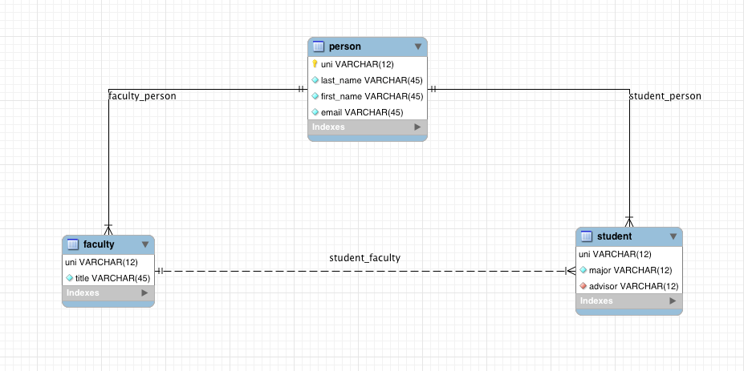

Slide 3

Module II – DBMS Architecture and Implementation
Reminder
3 | Introduction to Databases (F18): Lecture 8: Disks, I/O, Indexes

Slide 4
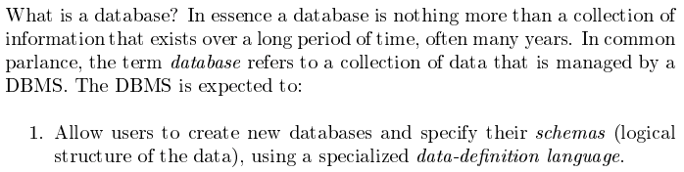
Database Management System Reminder
Covered for the relational model.
Database Systems: The Complete Book (2nd Edition) by Hector Garcia-Molina (Author), Jeffrey D. Ullman (Author), Jennifer Widom (Author)
4 | Introduction to Databases (F18): Lecture 8: Disks, I/O, Indexes © Donald F. Ferguson, 2018

Slide 5
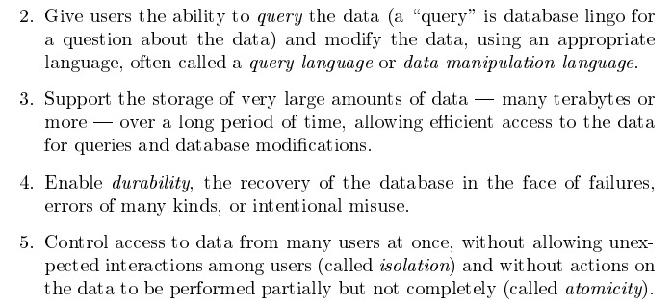
Database Management System Reminder
Focus for next part of course.
Database Systems: The Complete Book (2nd Edition) by Hector Garcia-Molina (Author), Jeffrey D. Ullman (Author), Jennifer Widom (Author)
5 | Introduction to Databases (F18): Lecture 8: Disks, I/O, Indexes © Donald F. Ferguson, 2018

Slide 6

Data Management
Find things quickly.
Access things quickly.
Load/save things quickly.
Database Systems: The Complete Book (2nd Edition) by Hector Garcia-Molina (Author), Jeffrey D. Ullman (Author), Jennifer Widom (Author)

Slide 7
Database Address Space
7 | Introduction to Databases (F18): Lecture 8: Disks, I/O, Indexes

Slide 8
Data Address Space (Overly Simplified)
The block/storage system represents block addresses with
A logical ID
That is simply a string, e.g. UUID or has some structure.
There is a logical address to physical address mapping table that maps a logical address to a physical address
Block/storage engine ID.
An opaque address string that the specific engine understands and manages.
For example, in a storage area network, the physical address might be
IP address of storage server.
ID of disk attached to the server.
{Cylinder, Head Number, Sector}
Any reference to a block, e.g. in an index node, uses the logical address.
Figuring out where, when and why to put a block in a specific engine/domain is an important optimization function in DMBS.

Slide 9
Data Address Space (Overly Simply)
Straightforward:
s-sever11.nas.myco.com
/var/dev1
The block/storage system represents block addresses with
A logical ID
That is simply a string, e.g. UUID or has some structure.
There is a logical address to physical address mapping table that maps a logical address to a physical address
Block/storage engine ID.
An opaque address string that the specific engine understands and manages.
For example, in a storage area network, the physical address might be
IP address of storage server.
ID of disk attached to the server.
{Cylinder, Head Number, Sector}
Any reference to a block, e.g. in an index node, uses the logical address.
Figuring out where, when and why to put a block in a specific engine/domain is an important optimization function in DMBS.
Most devices surface Logical Block Addressing.

Slide 10
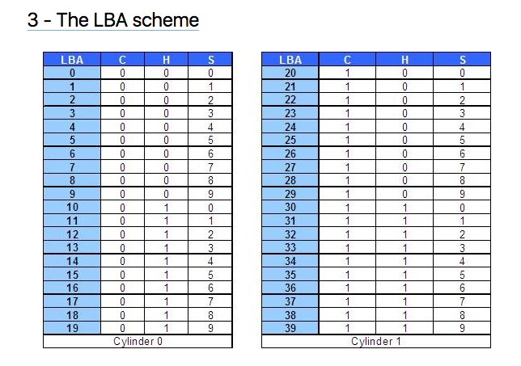
Logical Block Addressing (https://gerardnico.com/wiki/data_storage/lba)
CHS addresses can be converted to LBA addresses using the following formula:
LBA = (( C x HPC ) + H ) x SPT + S – 1
where,
C, H and S are the cylinder number, the head number, and the sector number
LBA is the logical block address
HPC is the number of heads per cylinder
SPT is the number of sectors per track
Devices have configuration and metadata APIs that allow storage manager to
Map between LBA and CHS
To optimize block placement
Based on access patterns, statistics, data schema, etc.

Slide 11
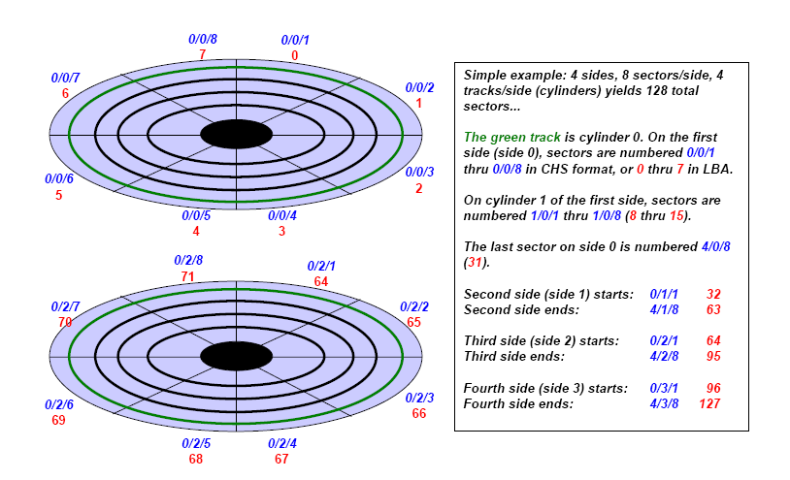
Another View (http://www.c-jump.com/CIS24/Slides/DiskDrives/D01_0150_chs_vs_lba.htm)

Slide 12
Summary
There is a broad category of storage devices
“Just a disk”
RAID-0, RAID-1, RAID-5, RAID-X/Y
Network/cloud addressable devices
SSD
A device has configuration information, often via APIs
Device geometry
Reliability metrics
IOPs, and sub-elements (seek, rotate, etc).
Storage management consists of using statistics and query (optimization patterns) to
Arrange records into blocks for storage and IO efficiency.
Place blocks on devices at LBAs to meet performance and IO objectives.

Slide 13
Summary
Almost all of this complexity and functionality is hidden from
Database developers.
Database designers and administrators.
Data center, cloud and large scale infrastructure architects
Evaluate and design disk technology and architecture
In combination with other critical technology, e.g.
Networking
Process/compute nodes.
Some customer, optimized, advanced data solutions are a combination of
Custom, optimized database implementation.
Co-designed with underlying infrastructure design.
The disk arrays and controllers do a lot of the low-level functions, but …
The database admin using DB analytics understands the access patterns.
And uses DB tools to choose, optimize and configure storage options.

Slide 14
Record and Block Management
14 | Introduction to Databases (F18): Lecture 8: Disks, I/O, Indexes

Slide 15
Terminology
A tuple in a relation maps to a record. Records may be
Fixed length
Variable length
Variable format (which we will see in Neo4J, DynamoDB, etc).
A block
Is the unit of transfer between disks and memory (buffer pools).
Contains multiple records, usually but not always from the same relation.
The database address space contains
All of the blocks and records that the database manages
Including blocks/records containing data
And blocks/records containing free space.

Slide 16
Fixed Length Record
Sample DDL
CREATE TABLE `products` ( `product_id` char(8) NOT NULL, `product_name` varchar(16) NOT NULL, `product_description` char(8) NOT NULL, `product_brand` enum('IBM','HP','Acer','Lenovo','Some really long brand name') NOT NULL, PRIMARY KEY (`product_id`) ) ENGINE=InnoDB DEFAULT CHARSET=utf8;
Why
Is this fixed length? product_brand and product_name are clearly variable length.
Isn’t char(8) to short for a product description?

Slide 17
Hypothetical Explanations
“In computing, internationalization and localization are means of adapting computer software to different languages, regional differences and technical requirements of a target locale.^{[1]} Internationalization is the process of designing a software application so that it can be adapted to various languages and regions without engineering changes. Localization is the process of adapting internationalized software for a specific region or language by adding locale-specific components and translating text. Localization (which is potentially performed multiple times, for different locales) uses the infrastructure or flexibility provided by internationalization (which is ideally performed only once, or as an integral part of ongoing development).” (https://en.wikipedia.org/wiki/Internationalization_and_localization)
Retrieving a product description may require two elements
Language code, e.g. (EN, DE, ES, …)
Description ID, e.g. 01105432
(EN, 01105432) and (DE, 01105432) are the same description in different languages (English and German)
The description ID is an attribute of the product.
The language is an attribute or property of the user, install location, etc.

Slide 18
Hypothetical Explanations
This concept is
An element of data modeling and design
Not DBMS implementation or data management.
I introduce the concept because
Important, general data model topic we have not covered.
Pattern is a reason why many records we think would be variable are often fixed.
VARCHAR field in a tuple is often
A pointer to a value in some other record.
“In computing, internationalization and localization are means of adapting computer software to different languages, regional differences and technical requirements of a target locale.^{[1]} Internationalization is the process of designing a software application so that it can be adapted to various languages and regions without engineering changes. Localization is the process of adapting internationalized software for a specific region or language by adding locale-specific components and translating text. Localization (which is potentially performed multiple times, for different locales) uses the infrastructure or flexibility provided by internationalization (which is ideally performed only once, or as an integral part of ongoing development).” (https://en.wikipedia.org/wiki/Internationalization_and_localization)
Retrieving a product description may require two elements
Language code, e.g. (EN, DE, ES, …)
Description ID, e.g. 01105432
(EN, 01105432) and (DE, 01105432) are the same description in different languages.
The description ID is an attribute of the product.
The language is an attribute or property of the user, install location, etc.

Slide 19
Hypothetical Explanation
`product_name` varchar(16) NOT NULL
(NB: Assumes that the product_name is not localized).
Length can be 0 .. 15 characters.
But,
If the value is almost always between 12 and 16 characters.
The database engine may decide to store in a fixed length area.
Because the relatively small savings available from treating like a variable length record
Does not justify the added complexity involved in variable size record management.
`product_brand` enum('IBM','HP','Acer','Lenovo','Some really long brand name')
The DB engine would/could represent with a 1 byte code in a lookup table.
This enables simplified, fixed length record management
And saves space because
1,000 products in the catalog from ‘Some really long brand’
Requires 1,000 bytes instead of 27,000 bytes.
Repeated values:
The same value occurring repeatedly in multiple distinct tuples is common, even when not an enum, e.g.
Country names, City names, street names, last names, first names, …
Foreign keys in many-to-many associative entities.
DBMS storage management engine may detect the situation, and replace values with symbol lookups.

Slide 20
Fixed Length Record
product_id
product_name
product_description
product_brand_code
Schema ID
… …
Timestamp
The record has
Database specific header fields, e.g.
Format information
Last modified
Areas for each of the fixed length fields.

Slide 21
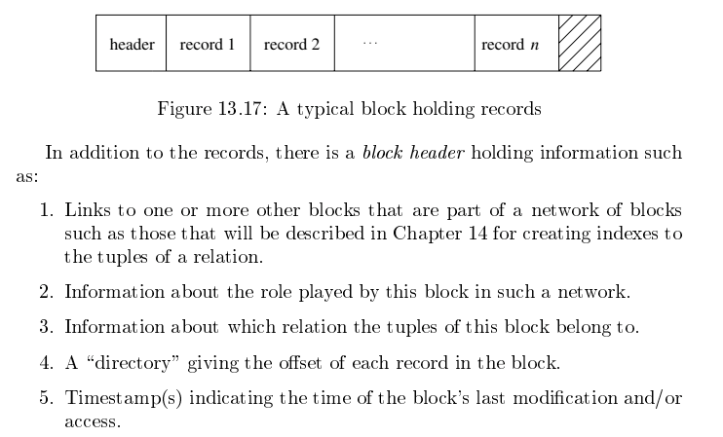
Packing Fixed Length Blocks
Database Systems: The Complete Book (2nd Edition)
by Hector Garcia-Molina and Jeffrey D. Ullman

Slide 22
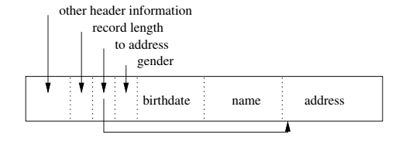
Variable Length Record
Same DBMS specific header information as fixed-length, plus
Record length.
Offset into record for each of the fields.
Variable sized areas for each of the variable sized fields.

Slide 23
Record Formats: Fixed Length
F1
F2
F3
F4
L1
L2
L3
L4
Base address (B)
Address = B+L1+L2
Information about field types same for all records in a file; stored in system catalogs.
Finding i’th field does not require scan of record.
Notes:
9

Slide 24
Record Formats: Variable Length
Two alternative formats (# fields is fixed):
F1 F2 F3 F4
4
$
$
$
$
Fields Delimited by Special Symbols
Field
Count
F1 F2 F3 F4
Array of Field Offsets
Second offers direct access to i’th field, efficient storage
of nulls (special don’t know value); small directory overhead.
Notes:
10

Slide 25
INSERT, DELETE, UPDATE
Fixed Length Records
H
R1
R4
E1
R2
E2
R3
Variable Length Records
H
R1
E1
R4
R2
R3
E2
INSERT, UPDATE and DELETE
Is pretty straightforward for fixed length records
But can get pretty interesting for variable length records, e.g.
What if INSERTed R5 is bigger than E1 or E2?
How do I expand R2?
Deleting R2 leaves a small gap → Fragmentation?

Slide 26
One (Simple) Solution is …
The block does not look like this in memory.
Variable Length Records
H
R1
E1
R4
R2
R3
E2
It always looks like this in memory …
Variable Length Records
H
R1
R4
R2
R3
E1
INSERT always goes into the start of E1.
DELETE or UPDATE R4:
Move (R2,R3) to end of R1
If R4 updated, move to end of new position of R3.

Slide 27
Page Formats: Fixed Length Records
Slot 1
Slot 1
Slot 2
Slot 2
. . .
Free
Space
. . .
Slot N
Slot N
Slot M
N
1
. . .
1
1
0
M
number
of records
M ... 3 2 1
number
of slots
PACKED
UNPACKED, BITMAP
Record id = <page id, slot #>. In first alternative, moving records for free space management changes rid; may not be acceptable.
Notes:
11

Slide 28
Page Formats: Variable Length Records
Rid = (i,N)
Page i
Rid = (i,2)
Rid = (i,1)
20
16
24
N
Pointer
to start
of free
space
N . . . 2 1
# slots
SLOT DIRECTORY
Can move records on page without changing rid; so, attractive for fixed-length records too.
Notes:
12

Slide 29
Block and Record Addresses
Disk Room 1
Blocks and records have addresses
Index tables map an index entry to {block, record}
SELECT scan on a table needs a logical linked list of the blocks holding records, e.g. “next block.”
Index elements are themselves blocks, and need to reference other nodes in the index.
But, …
The blocks can be all over the place, and
Each “place” has a different address format and access protocol.
Disk Room 2
Cloud 1
Tape Library
Cloud 2

Slide 30
Data Address Space (Overly Simply)
The block/storage system represents block addresses with
A logical ID
That is simply a string, e.g. UUID or has some structure.
There is a logical address to physical address mapping table that maps a logical address to a physical address
Block/storage engine ID.
An opaque address string that the specific engine understands and manages.
For example, in a storage area network, the physical address might be
IP address of storage server.
ID of disk attached to the server.
{Cylinder, Track, Sector}
Any reference to a block, e.g. in an index node, uses the logical address.
Figuring out where, when and why to put a block in a specific engine/domain is an important optimization function in DMBS.

Slide 31
Buffer Pools
31 | Introduction to Databases (F18): Lecture 8: Disks, I/O, Indexes

Slide 32
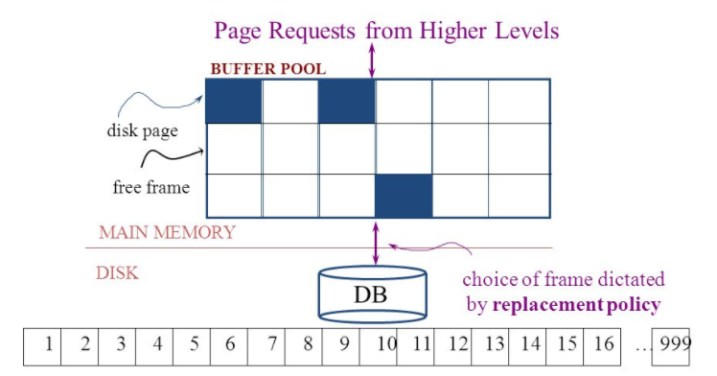
The Logical Concept
The DBMS and queries can only manipulate in-memory blocks and records.
A very, very, very small fraction of all blocks fit in memory.

Slide 33
When a Page is Requested ...
If requested page is not in pool:
Choose a frame for replacement
If frame is dirty, write it to disk
Read requested page into chosen frame
Pin the page and return its address.
If requests can be predicted (e.g., sequential scans)
pages can be pre-fetched several pages at a time!
Notes:
5

Slide 34
More on Buffer Management
Requestor of page must unpin it, and indicate whether page has been modified:
dirty bit is used for this.
Page in pool may be requested many times,
a pin count is used. A page is a candidate for replacement iff pin count = 0.
CC & recovery may entail additional I/O when a frame is chosen for replacement. (Write-Ahead Log protocol; more later.)
Notes:
6

Slide 35
Buffer Replacement Policy
Frame is chosen for replacement by a replacement policy:
Least-recently-used (LRU), Clock, MRU etc.
Policy can have big impact on # of I/O’s; depends on the access pattern.
Sequential flooding: Nasty situation caused by LRU + repeated sequential scans.
# buffer frames < # pages in file means each page request causes an I/O. MRU much better in this situation (but not in all situations, of course).
Notes:
7

Slide 36
DBMS vs. OS File System
OS does disk space & buffer mgmt: why not let OS manage these tasks?
Differences in OS support: portability issues
Some limitations, e.g., files can’t span disks.
Buffer management in DBMS requires ability to:
pin a page in buffer pool, force a page to disk (important for implementing CC & recovery),
adjust replacement policy, and pre-fetch pages based on access patterns in typical DB operations.
Notes:
8

Slide 37
Replacement Policy
The replacement policy is one of the most important factors in database management system implementation and configuration.
A very simple, introductory explanation is (https://en.wikipedia.org/wiki/Cache_replacement_policies).
There are a lot of possible policies.
The most efficient caching algorithm would be to always discard the information that will not be needed for the longest time in the future. This optimal result is referred to as Bélády's optimal algorithm/simply optimal replacement policy or the clairvoyant algorithm.
All implementable policies are an attempt to approximate knowledge of the future based on knowledge of the past.
Least Recently Used is based on the simplest assumption
The information that will not be needed for the longest time.
Is the information that has not been accessed for the longest time.

Slide 38
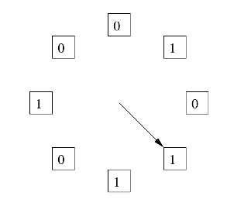
The “Clock Algorithm”
LRU is (perceived to be) expensive
Maintain timestamp for each block.
Update and resort blocks on access.
The “Clock Algorithm” is a less expensive approximation.
Arrange the frames (places blocks can go) into a logical circle like the seconds on a clock face.
Each frame is marked 0 or 1.
Set to 1 when block added to frame.
Or when application accesses a block in frame.
Replacement choice
Sweep second hand clockwise one frame at a time.
If bit is 0, choose for replacement.
If bit is 1, set bit to zero and go to next frame.
The basic idea is. On a clock face
If the second hand is currently at 27 seconds.
The 28 second tick mark is “the least recently touched mark.”

Slide 39
Replacement Algorithm
The algorithms are more sophisticated in the real world, e.g.
“Scans” are common, e.g. go through a large query result in order (will be more clear when discussing cursors).
The engine knows the current position in the result set.
Uses the sort order to determine which records will be accessed soon.
Tags those blocks as not replaceable.
(A form of clairvoyance).
Not all users/applications are equally “important.”
Classify users/applications into priority 1, 2 and 3.
Sub-allocate the buffer pool into pools P1, P2 and P3.
Apply LRU within pools and adjust pool sizes based on relative importance.
This prevents
A high access rate, low-priority application from taking up a lot of frames
Result in low access, high priority applications not getting buffer hits.

Slide 40
Summary
Like all other aspects of DMBS implementation
Block management
Buffer management
Are incredibly complex, heavily researched topics.
This course section has just skimmed the surface
Awareness of concepts.
Foundation for future more advanced courses.
Understand concepts to consider, research, prototype, etc. if you have to implement your own data management engine.

Slide 41
Indexes
41 | Introduction to Databases (F18): Lecture 8: Disks, I/O, Indexes

Slide 42
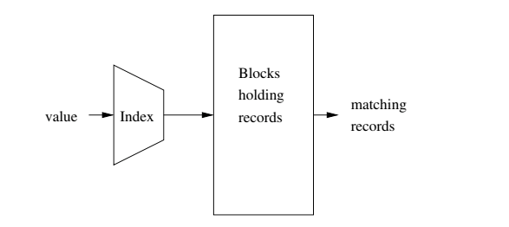
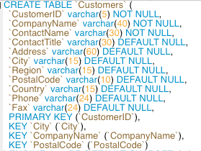
Index
Block will map to
In memory block in frame or
Address in Data Address Space.
Column values or set of column values.
Garcia-Molina et al.
Indexes are created on
Simple keys = e.g. a single column.
Composite keys = a set of columns, e.g. (last_name, first_name)
Most common index implementations are: Hash, B+ Tree
An entry in an index if of the form – (k, v):
k is the key value.
v is one of: 1) the data itself (tuple), 2) the address in data address space of tuple, 3) a list of addresses
Index can be unique/non-unique, dense/sparse, clustered/unclustered, ordered/hashed.

Slide 43
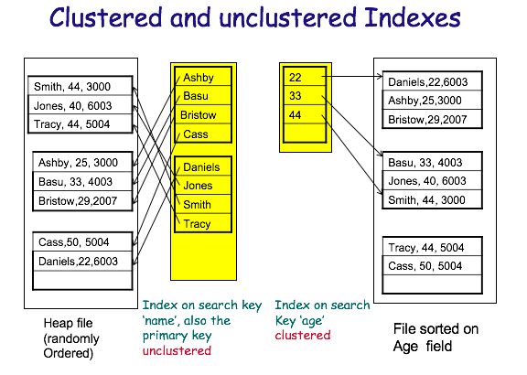
Clustered vs Unclustered
Order of keys in index is approximately the same as order of records in file.

Slide 44
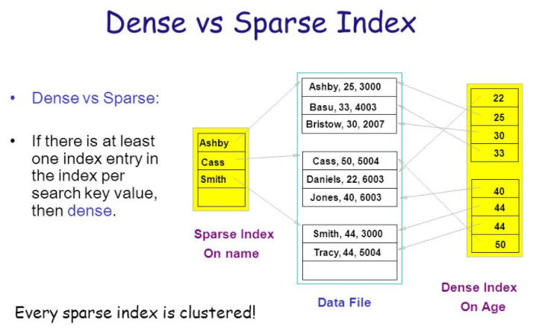
Dense versus Sparse Index
“Storage and File Structure. Architecture of a DBMS,” Shona Holmes.
http://slideplayer.com/slide/6841281/

Slide 45
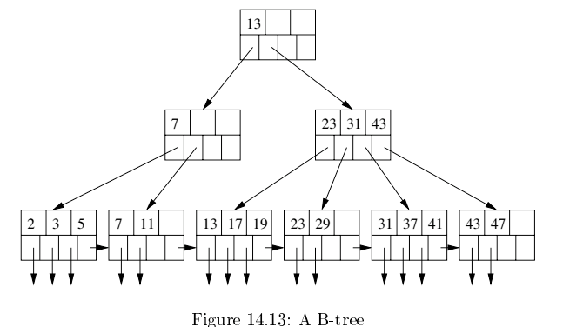
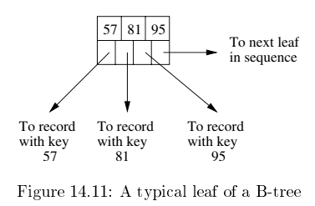
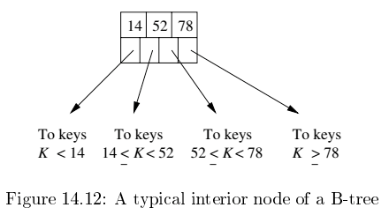
B+ Tree
Based on concept of a binary search tree, but with two core modifications
Unit of transfer to/from memory is a block, which will hold many (key,record) maps.
Accessing records in order (WRT to index) is common → clustering is common.

Slide 46
B+ Tree: Most Widely Used Index
Insert/delete at log _{F} N cost; keep tree height-balanced. (F = fanout, N = # leaf pages)
Minimum 50% occupancy (except for root). Each node contains d <= m <= 2d entries. The parameter d is called the order of the tree.
Supports equality and range-searches efficiently.
Index Entries
(Direct search)
Data Entries
("Sequence set")
Notes:
9

Slide 47
Example B+ Tree
Search begins at root, and key comparisons direct it to a leaf (as in ISAM).
Search for 5*, 15*, all data entries >= 24* ...
Root
13
17
24
30
2*
3*
5*
7*
14*
16*
19*
20*
22*
24*
27*
29*
33*
34*
38*
39*
Based on the search for 15*, we know it is not in the tree!
Notes:
10

Slide 48
B+ Trees in Practice
Typical order: 100. Typical fill-factor: 67%.
average fanout = 133
Typical capacities:
Height 4: 133⁴ = 312,900,700 records
Height 3: 133³ = 2,352,637 records
Can often hold top levels in buffer pool:
Level 1 = 1 page = 8 Kbytes
Level 2 = 133 pages = 1 Mbyte
Level 3 = 17,689 pages = 133 MBytes

Slide 49
Prefix Key Compression
Important to increase fan-out. (Why?)
Key values in index entries only `direct traffic’; can often compress them.
E.g., If we have adjacent index entries with search key values Dannon Yogurt, David Smith and Devarakonda Murthy, we can abbreviate David Smith to Dav. (The other keys can be compressed too ...)
Is this correct? Not quite! What if there is a data entry Davey Jones? (Can only compress David Smith to Davi)
In general, while compressing, must leave each index entry greater than every key value (in any subtree) to its left.
Insert/delete must be suitably modified.

Slide 50
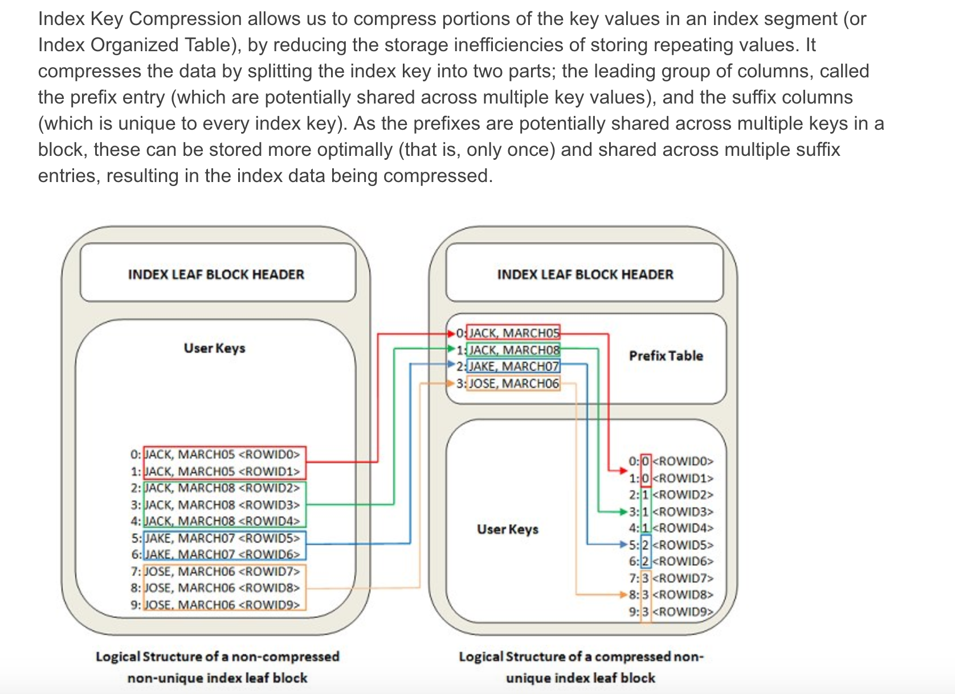
Index
Key
Compression

Slide 51
Static Hashing
Buckets contain data entries.
Hash fn works on search key field of record r. Must distribute values over range 0 ... M-1.
h(key) = (a * key + b) usually works well.
a and b are constants; lots known about how to tune h.
Long overflow chains can develop and degrade performance.
Extendible and Linear Hashing: Dynamic techniques to fix this problem.
Notes:
4

Slide 52
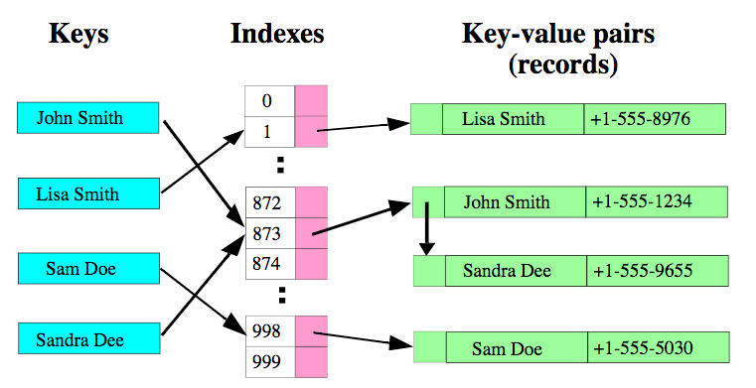
Hash Index – Basic Data Structure

Slide 53
Database Hash Index
Index blocks are disk blocks, just like data blocks.
The format is
Key value
Data value
The data value may be
The actual record, or
The logical address for the data block and record ID holding the tuple.
Block 0
Block 1
H(x) = x MOD 5
Block 2
Key = X
Block 3
Block 4
Block 2 -- Overflow

Slide 54
Some Comparisons
B-Tree supports
WHERE operators =, >, >=, <, <=, BETWEEN and LIKE (for operands).
MIN(), MAX()
ORDER BY
WHERE clauses with partial keys and AND. A key on (c1, c2, c2) is actually a set of indexes of the form (c1), (c1,c2) and (c1,c2,c3).
Estimates of the number of records in a range (for query optimization).
Hash Index
Extremely fast for the (key, value) data model.
Only for operators =, NOT =
Does not support partial keys.

Slide 55
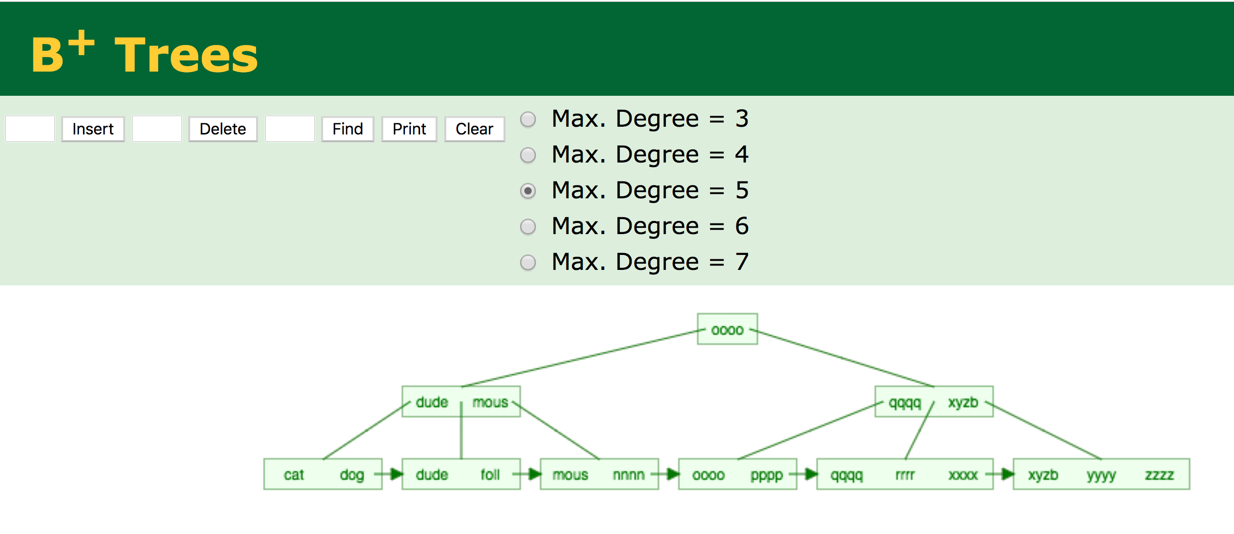
Some Simulators
https://www.cs.usfca.edu/~galles/visualization/BPlusTree.html

Slide 56
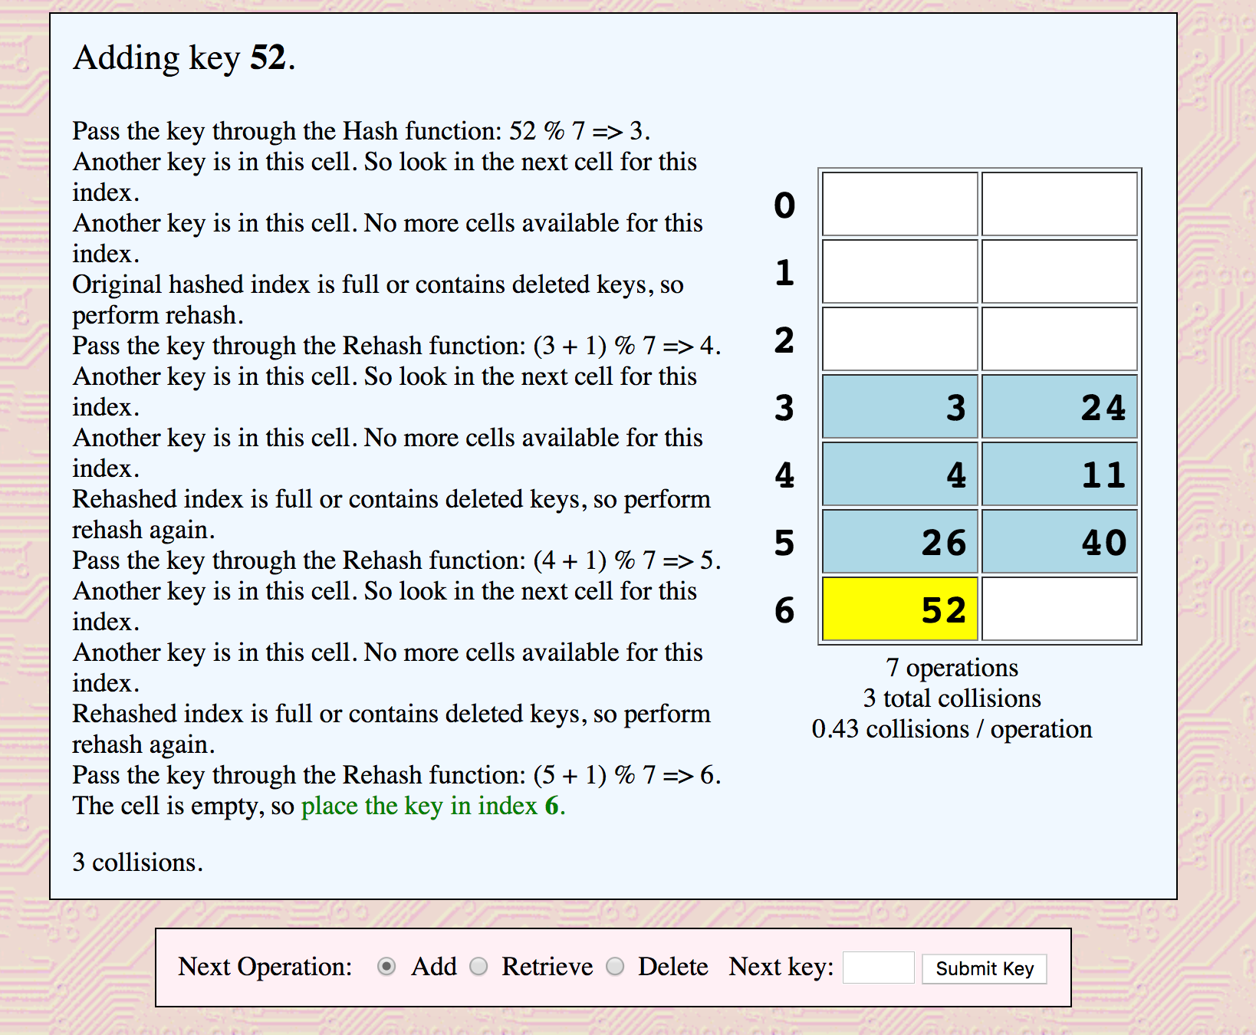
Some Simulators
http://www.cse.unt.edu/~donr/courses/2050/HashSimulator/hashsim.cgi
http://iswsa.acm.org/mphf/openDSAPerfectHashAnimation/perfectHashAV.html

Slide 57
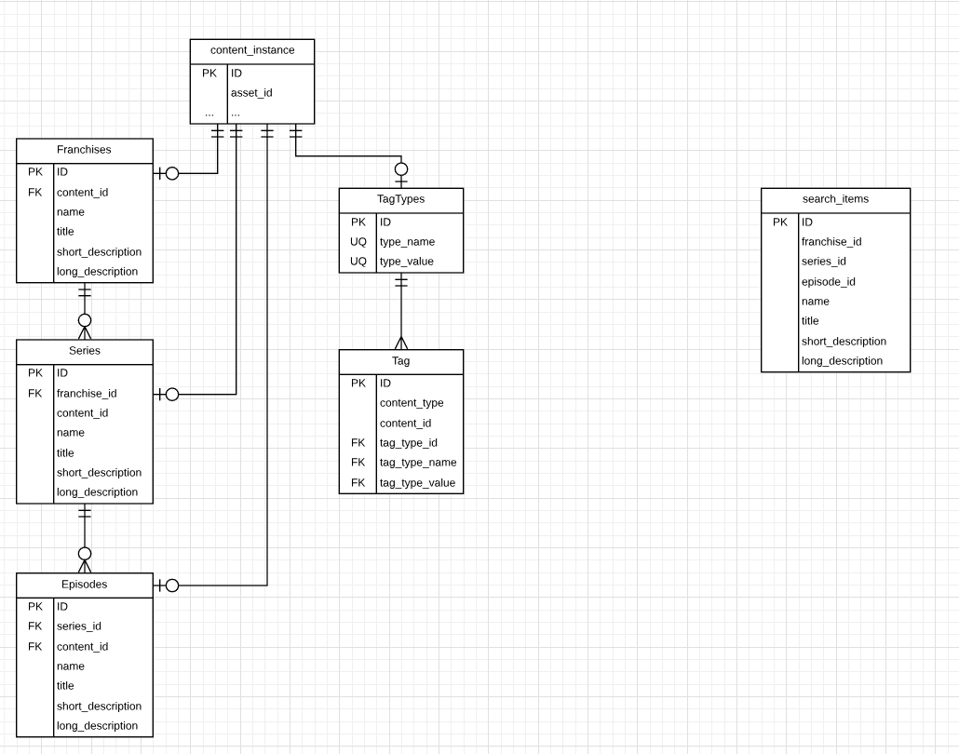
Seeka TV Search
Seeka TV Demo
Operational Data
Franchise
Series
Episode
Content_Instance
Tags
Types, e.g.
Genre
Rating
Values, e.g.
Humor
PD-13
SQL scripts merge into a single search table
Tags added to description
Full text search on title, name, short_description, long_desscription
SQL Scripts

Slide 58
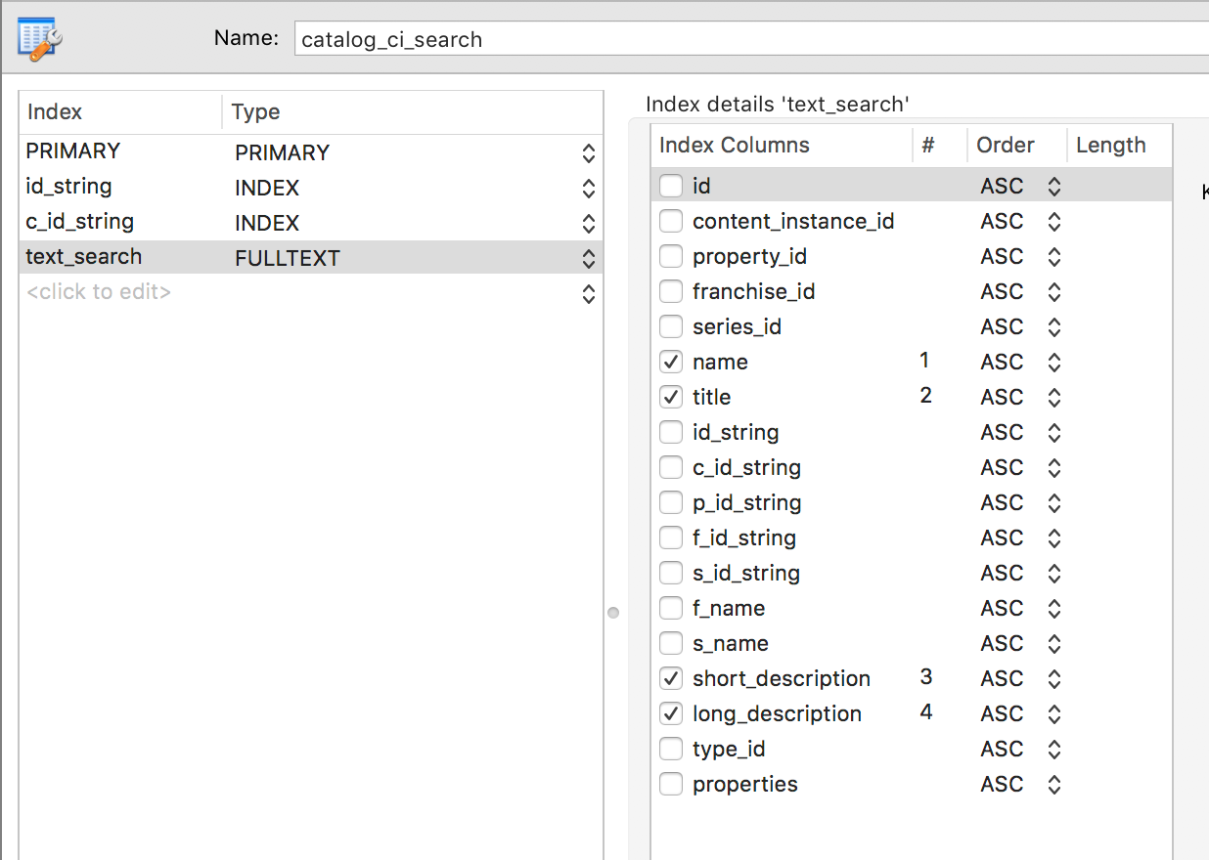
Seeka TV Demo
Uses MySQL FULLTEXT index
Text search in
Natural Language Mode
On columns
name
title
short_description
long_description
content_id and values returned to UI

Slide 59
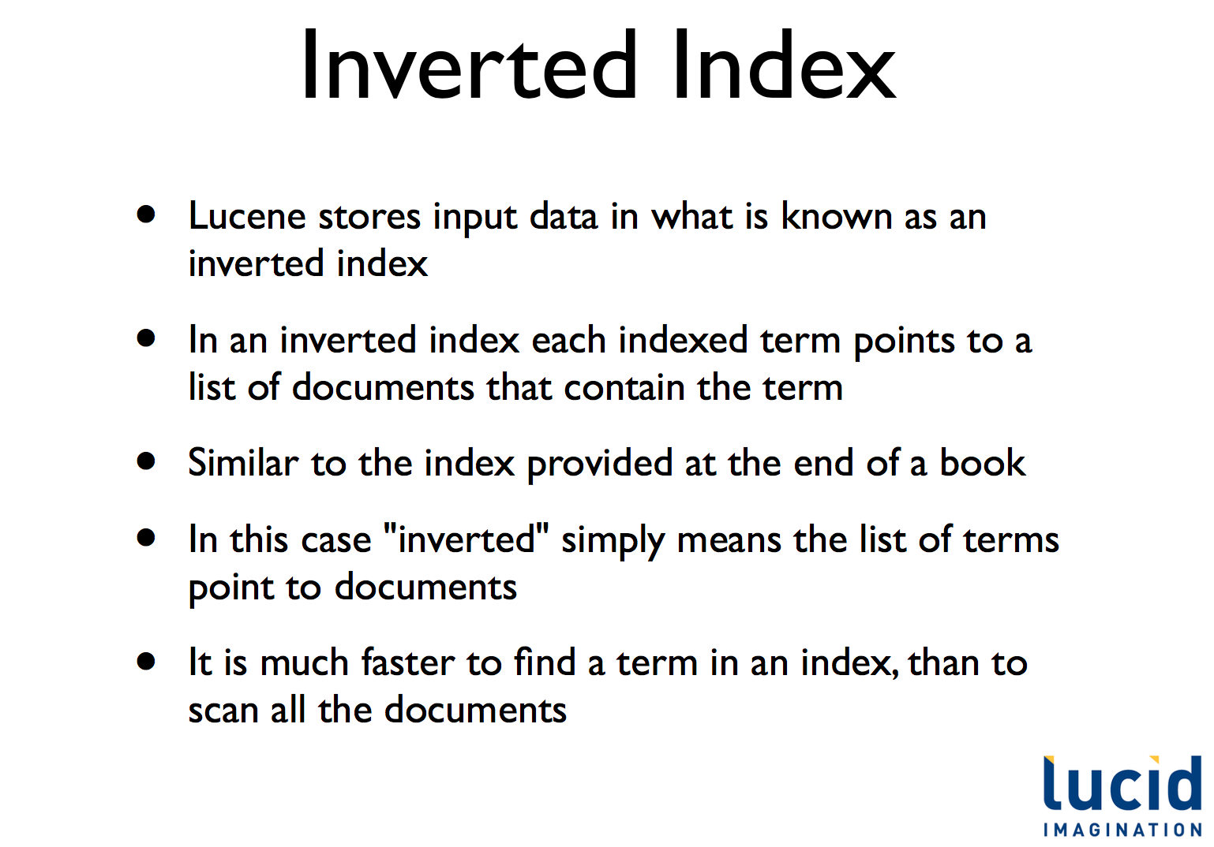
Lucene Inverted Index
We used MySQL because
Small number of “documents.”
Short documents.
Already using MySQL for operational data and reporting.
Most systems have a focused, dedicated text ingest and search engine.

Slide 60
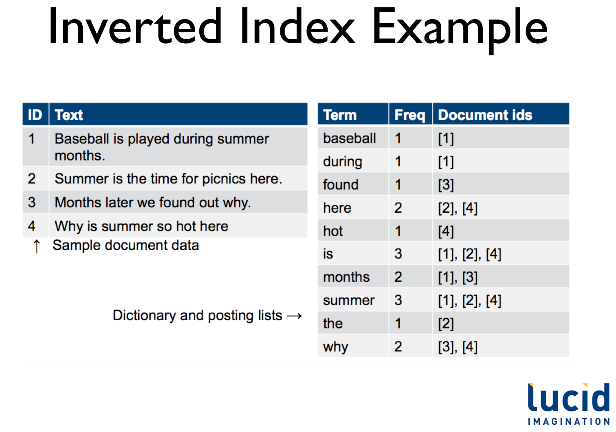
Lucene

Slide 61
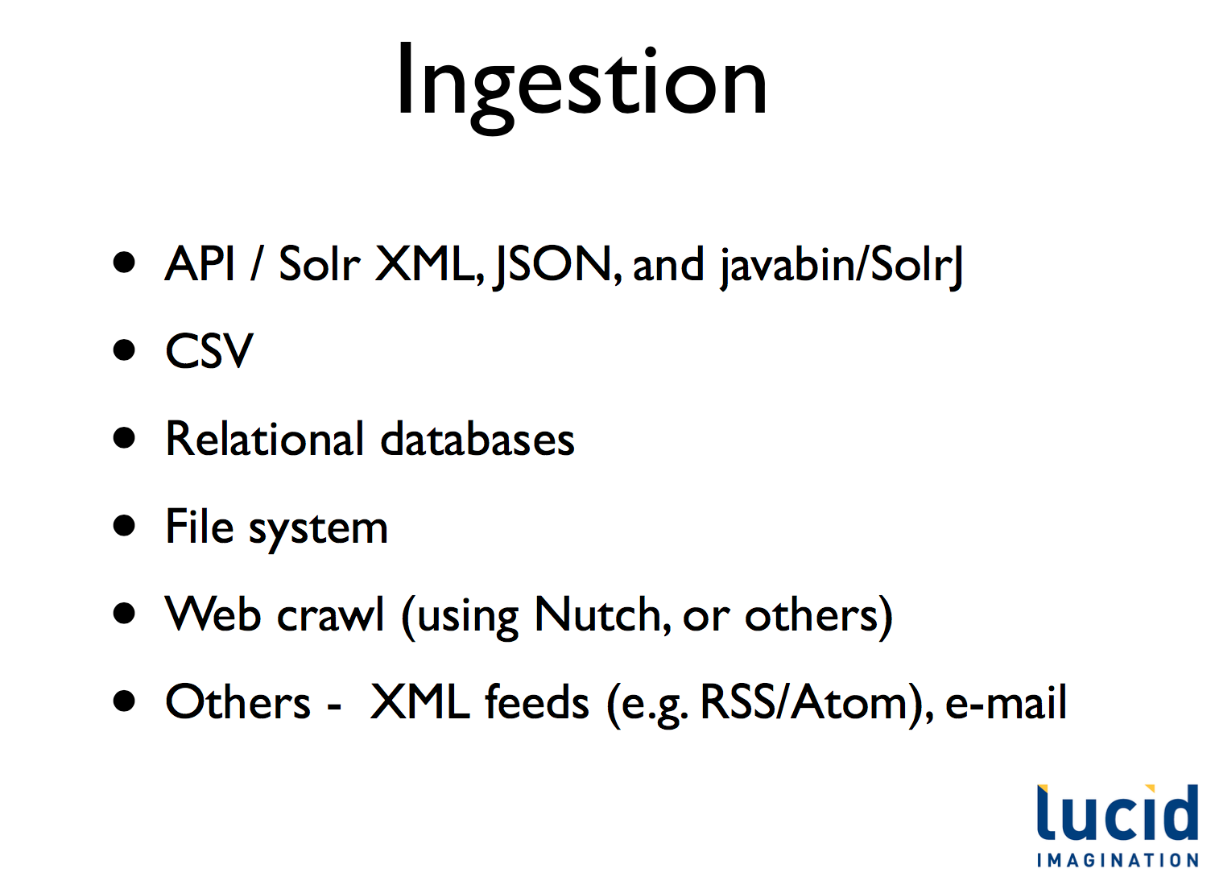
Ingestion

Slide 62
Homework 3 – Overview
62 | Introduction to Databases (F18): Lecture 8: Disks, I/O, Indexes

Slide 63
Homework 3 Overview
Expand on HW I – CSVDataTable
I will provide the base functions.
Placeholders for functions you will write.
You will develop
CSVCatalog: Holds information about tables
Columns
File name
Indexes
Extensions to CSVDataTable
Implement index definitions for search only.
Enforce basic integrity constraints using catalog information.
JOINs and join optimizations
Will provide a basic insight into some DBMS function implementation.
Will role out in two step: Catalog/integrity, Query optimization

